Slide 1

GYM MANAGEMENT SYSTEM.
HARRYS FITNESS

Slide 2
Objective:
Payment receipts at many Gyms are printed on paper. As a result, keeping all of the
paper receipts safe is tough for both gym members and gym trainers. When members
misplace their receipts, it might cause problems. Another issue that a gym owner may
have is that manually distributing messages about the gym's working and non-working
days becomes tough. These issues can be solved if there is an online application available.
This project can benefit both gym owners and gym users. Because all receipts are stored in
a digital format in this program, there is no risk of losing any confidential receipts. This
program will also alert the user (gym members) of their fees, as well as the gym owner of
payment receipts. In the future, this app could be expanded to include a supplement store,
nutrition advice, personal training, and other features.

Slide 3
Data sharing agreement:
Enter your NAME.
Enter your AGE.
GENDER.
Enter your LOCALITY.
Email.ID
Enter your PHONE NUMBER.

Slide 4
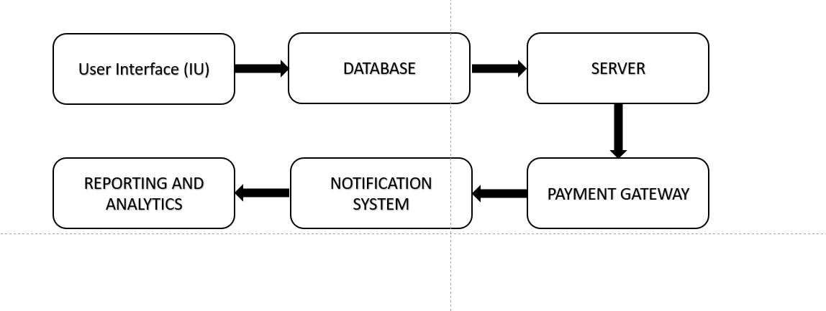
Architecture:

Slide 5
1.User Interface (UI): A web-based interface that allows gym members and gym owners to access the application and perform various tasks.
2.Database: A secure and reliable database to store all payment and receipt information, member information, and any other relevant data.
3.Server: A server to host the application and handle requests from the UI, communicate with the database, and perform any necessary processing.

Slide 6
4.Payment Gateway Integration: Integration with a payment gateway to facilitate secure and efficient payment transactions.
5.Notification System: A notification system to send reminders, alerts, and updates to both gym members and owners.
6.Reporting and Analytics: A reporting and analytics module to provide insight into payment and receipt data, member behavior, and other relevant metrics.

Slide 7
PREDICTION:
Increased Adoption of Cloud-Based Solutions: There is a growing trend towards cloud-based solutions, and it is likely that more gym management systems will adopt this model in the future, offering greater flexibility and accessibility for both gym owners and members.
Integration with Wearable Devices: As wearable fitness devices become more popular, it is likely that gym management systems will integrate with these devices to provide a more seamless experience for gym members.
Advanced Analytics: The use of advanced analytics and artificial intelligence is likely to become more widespread in gym management systems, providing valuable insights into member behavior and payment trends.
Personalized Experiences: Personalization is becoming an important aspect of many industries, and the gym industry is no exception. In the future, it is likely that gym management systems will provide more personalized experiences for gym members, including customized workout plans and nutrition advice.

